Slide 1

Fysisk (U)sikkerhed
IT SIKKERHED
https://jerichospecializedentrytraining.com/wp-content/uploads/2011/10/Jericho-Tactical-Team-Artwork.jpg

Slide 2
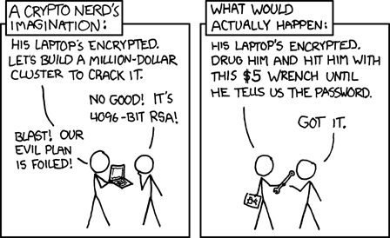
Fysisk (U)sikkerhed…

Slide 3
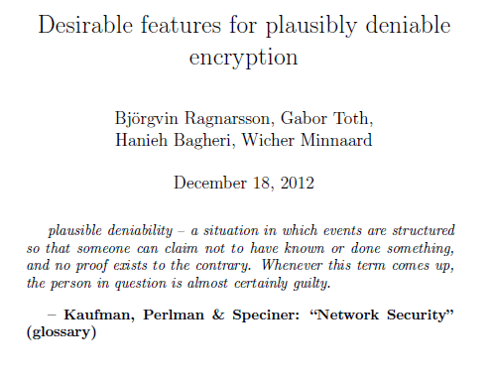
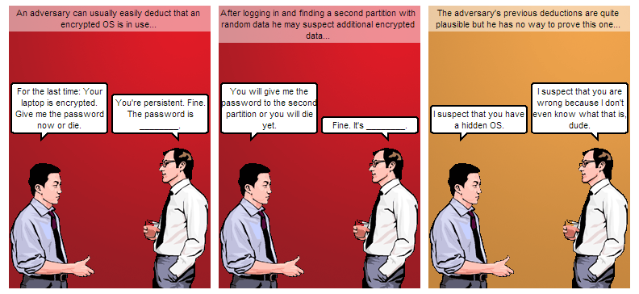
Fysisk (U)sikkerhed…

Slide 4
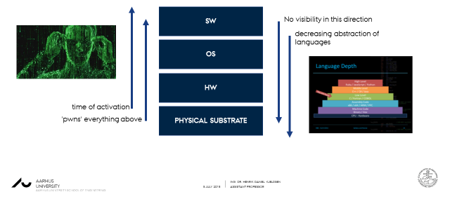
Fysisk adgang
Internet
Fysisk adgang ved list eller tvang.
Fysisk adgang by design
e.g. edge devices, IoT og mobil.
Fysisk adgang forstået som
evnen til at ændre den fysiske
virkelighed for systemet.
Secure channel
CLIENT
CLIENT
or
SERVER
end-point attacks
‘looking over your shoulder’
Keyloggers, hidden screencapture, bugged rooms, laser microphones side-channels etc..

Slide 5
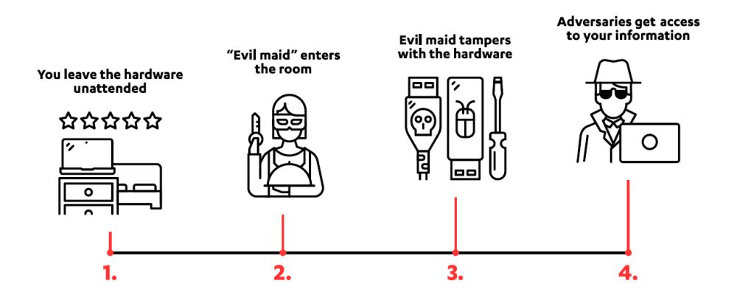
Fysisk adgang – EVIL MAIDS
EVIL MAID SCENARIO
Scene I: A Chief Financial Officer (CFO) at a conference leaves her laptop in her hotel room during dinner, confident that any corporate data on the laptop is safe because the hard drive is encrypted.
Scene II: An evil maid (who is actually a corporate spy involved in industrial espionage) spots the CFO leaving her room.
Scene III: The evil maid sneaks into the CFO's room and boots up her laptop from a compromised bootloader on a USB stick. The evil maid then installs a keylogger to capture the CFO's encryption key and shuts the laptop back down.
Scene IV: The CFO returns from dinner and boots up her computer. Suspecting nothing, she enters her encryption key and unlocks the laptop's disk drive.
Scene V: The following morning, while the CFO is downstairs at breakfast, the evil maid comes back and retrieves the keylogger which now knows the CFO's encryption key.
https://www.quora.com/Is-it-possible-to-prevent-evil-maid-attacks
F-Secure-Evil-Maid-Guide.pdf

Slide 6
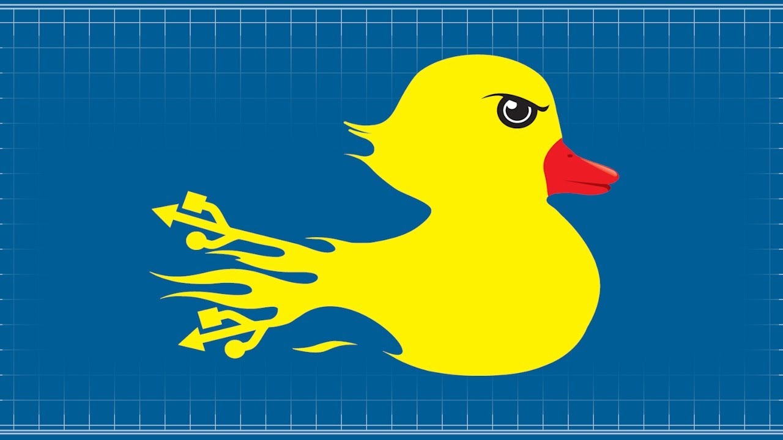
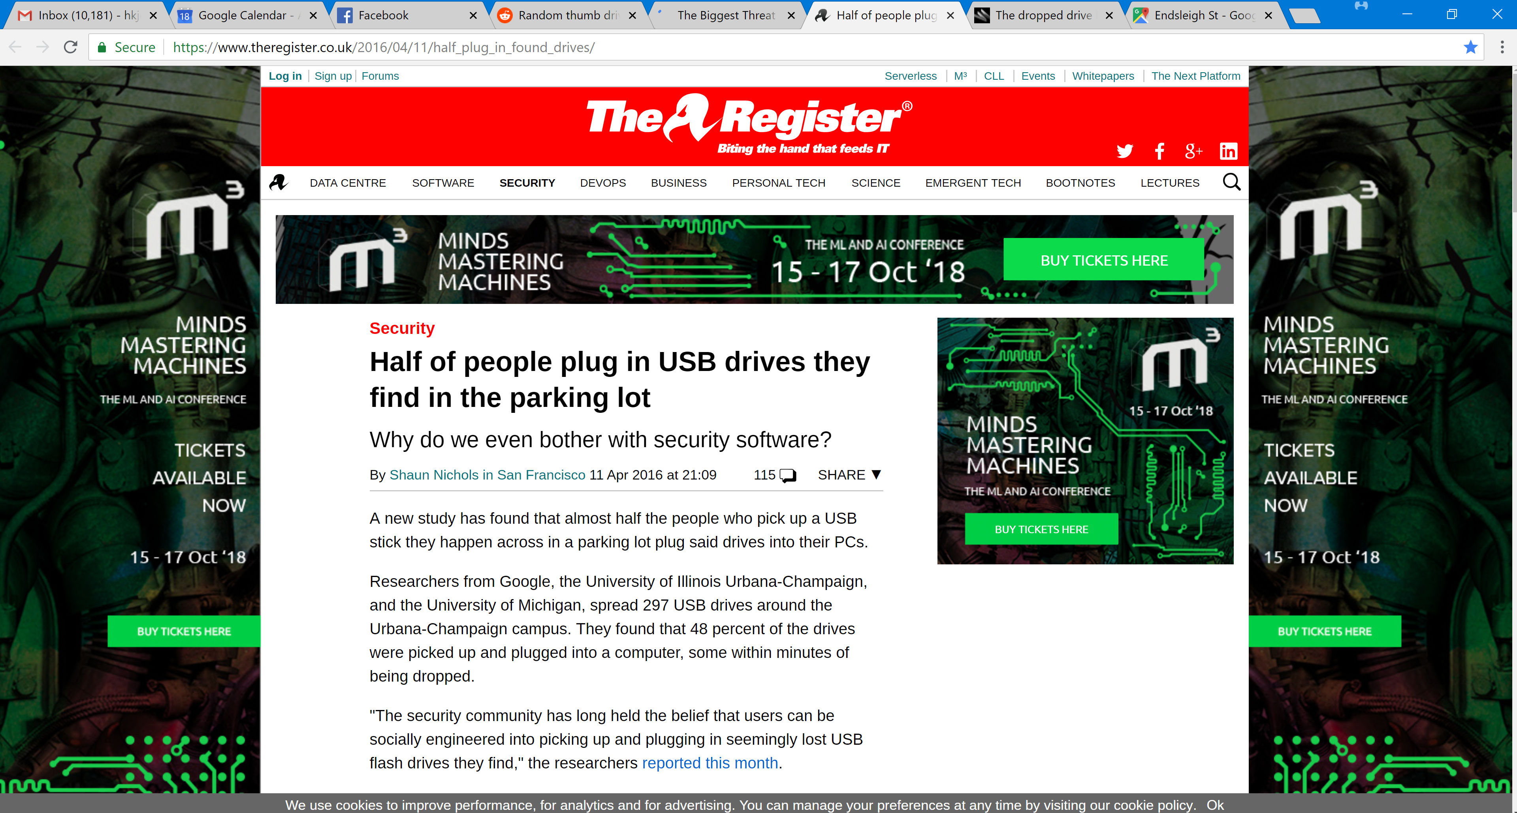
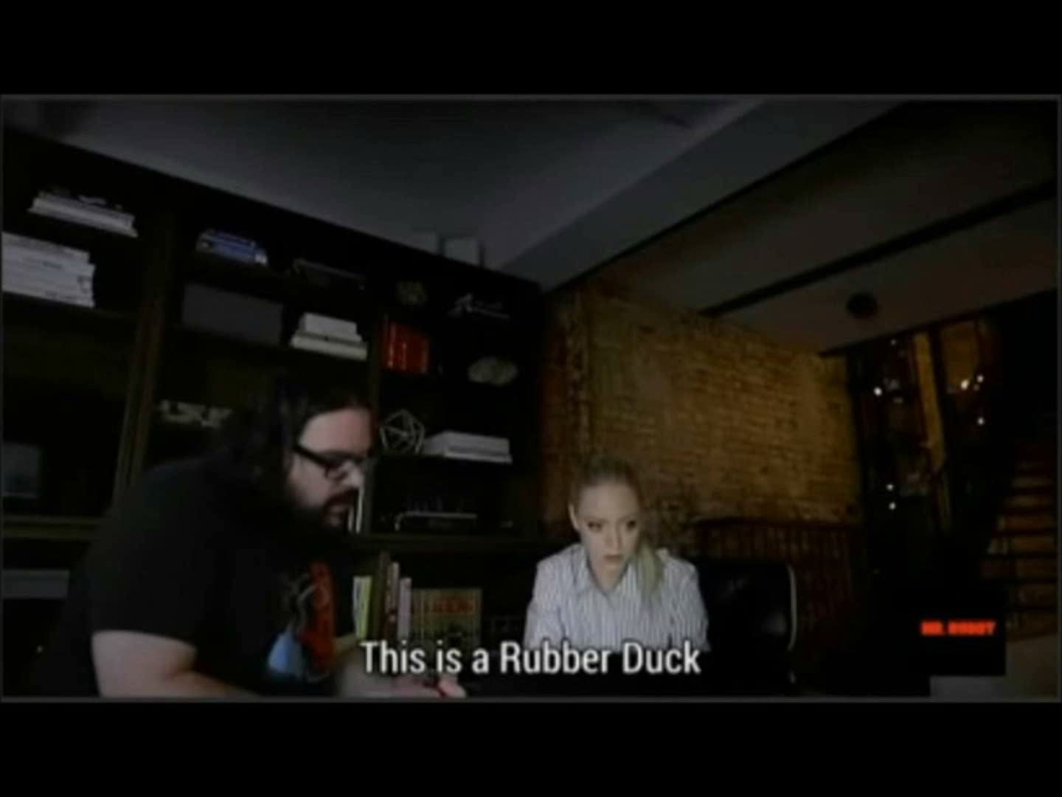
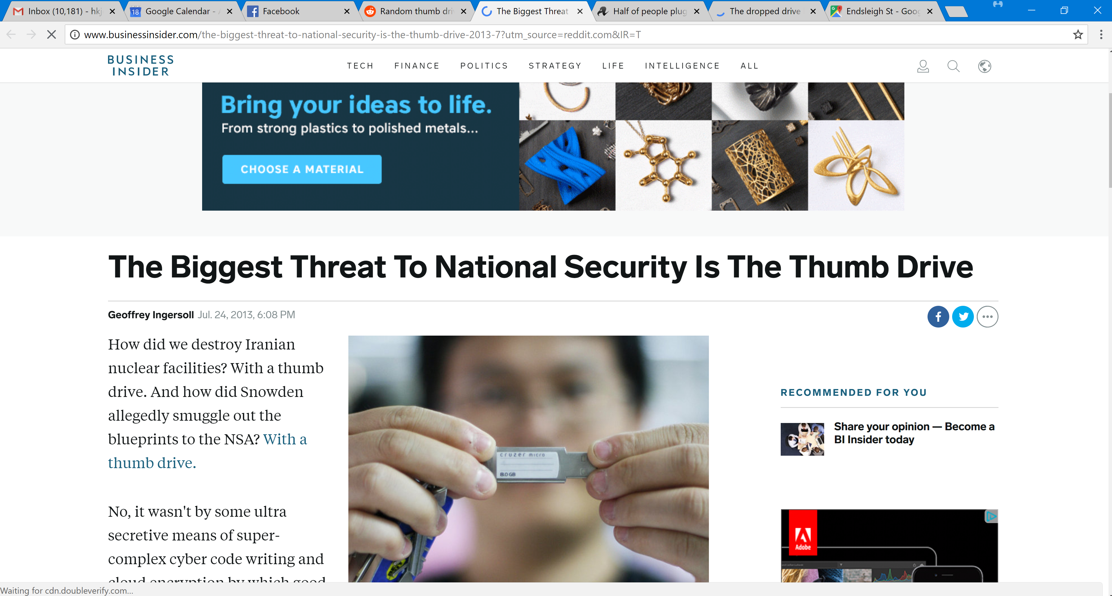
Fysisk adgang – Rubber Ducky

Slide 7
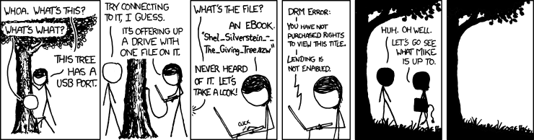
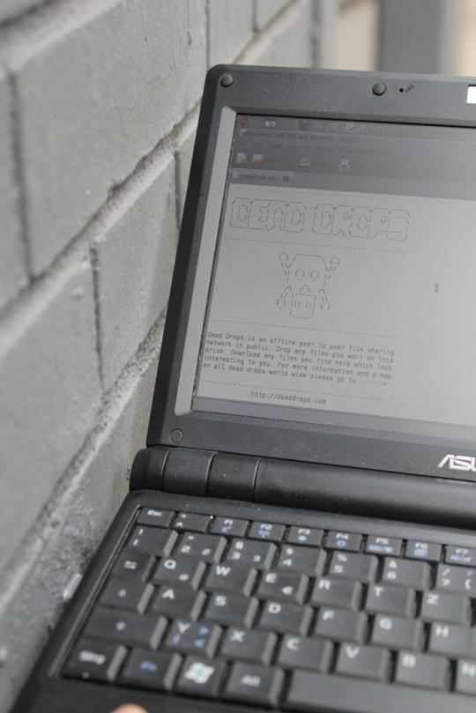
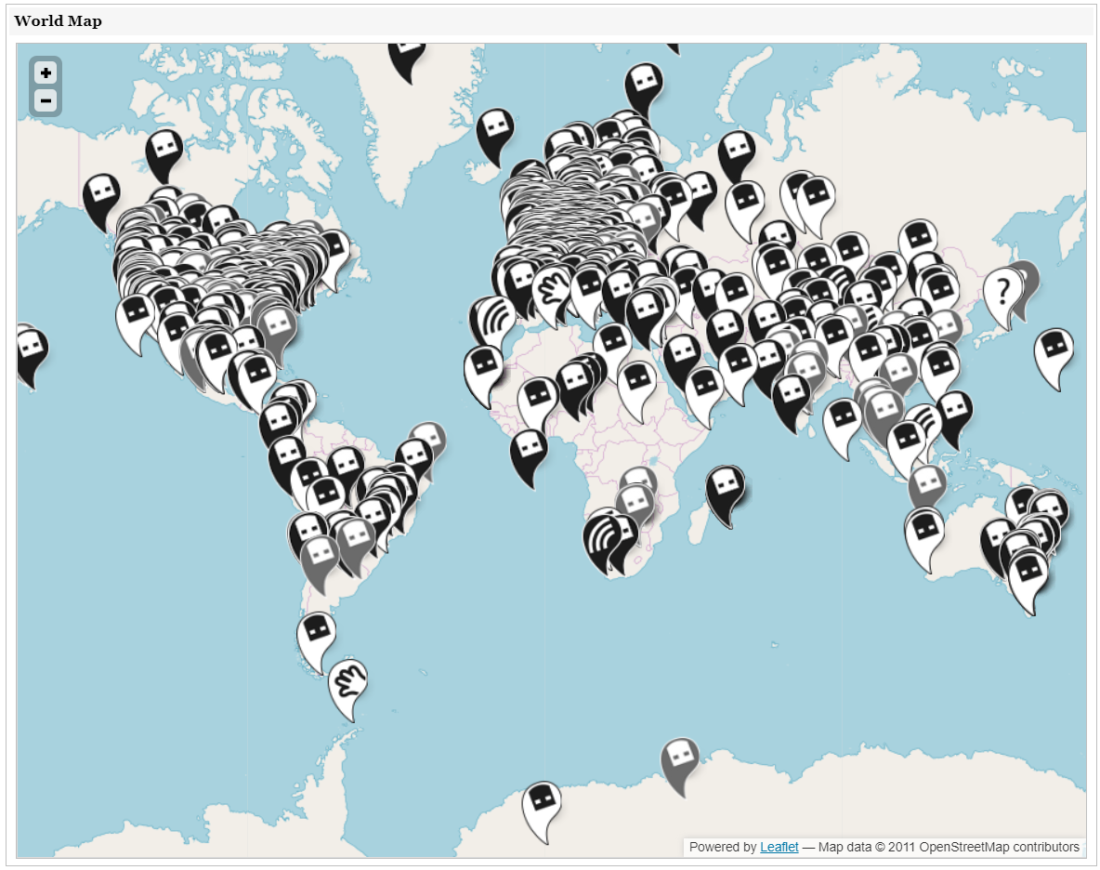
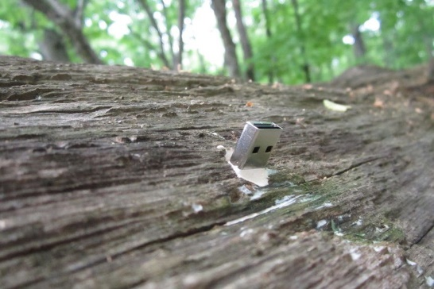
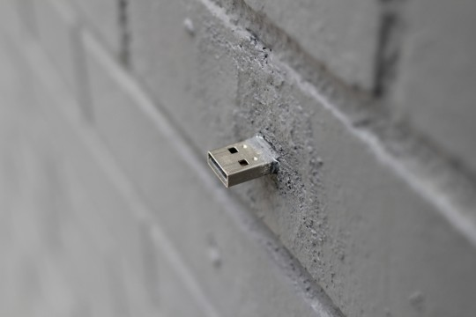

Fysisk adgang – Rubber Ducky

Slide 8
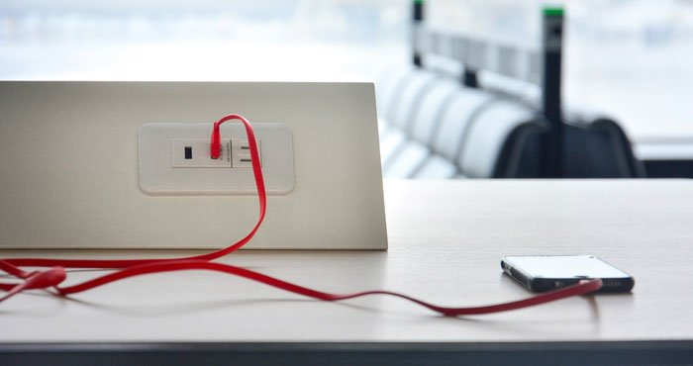
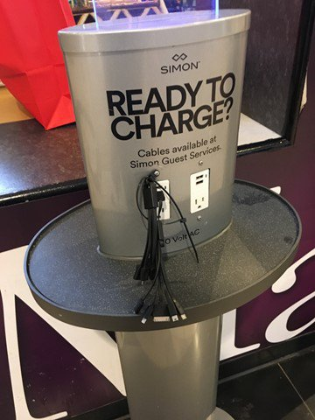
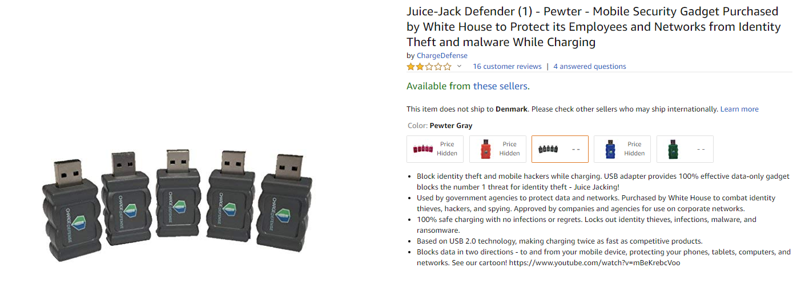
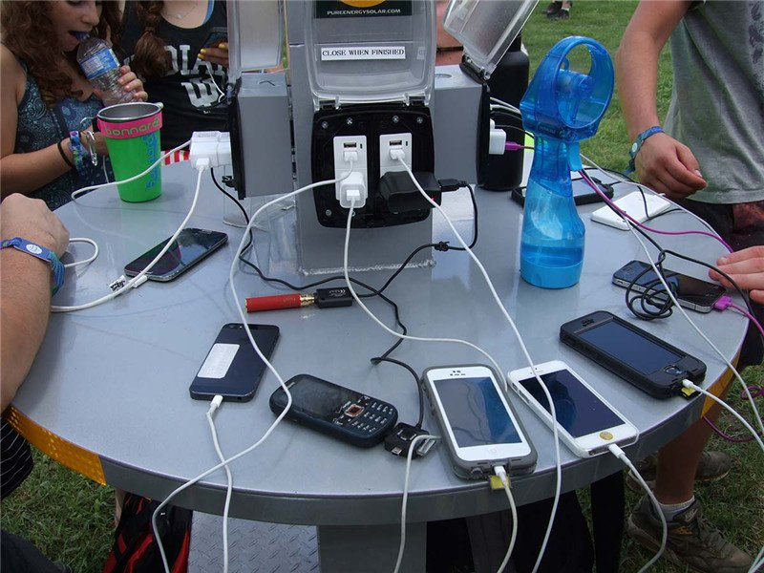
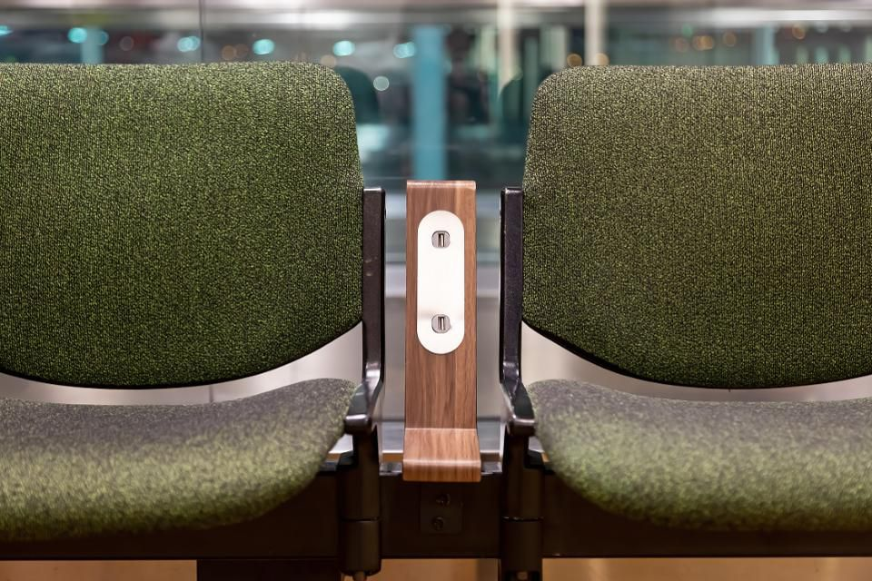
Fysisk adgang – Rubber Ducky

Slide 9
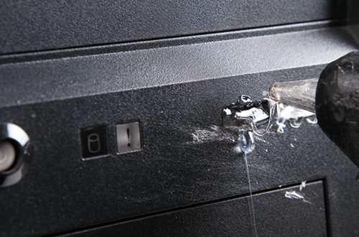
Fysisk adgang – Rubber Ducky
Forsvar mod Rubber Ducky:
Lås computer.
Lås kontor.
Disable USB.
Fyld USB porte med epoxy.
Detect keyboard.
Detect keystroke speed.

Slide 10
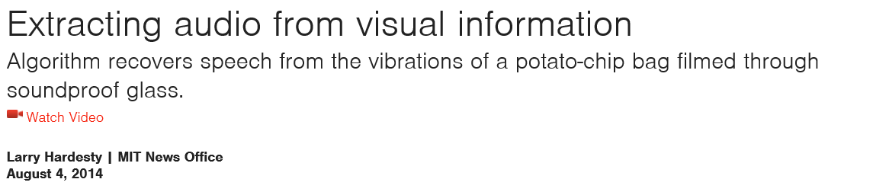

Fysisk adgang – line of sight
https://www.youtube.com/watch?v=FKXOucXB4a8

Slide 11
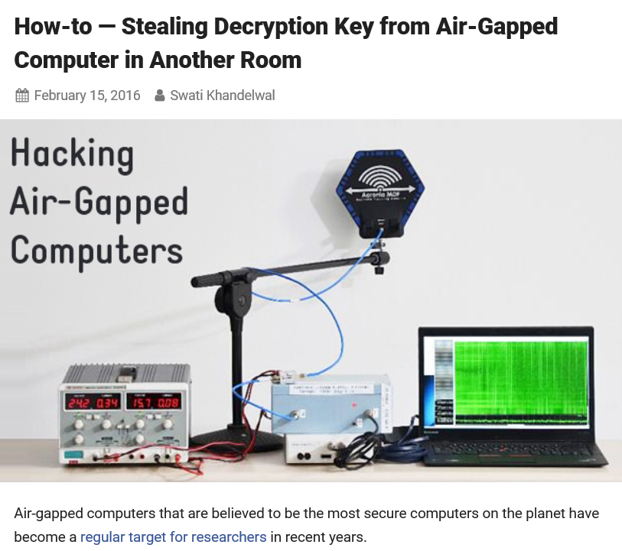
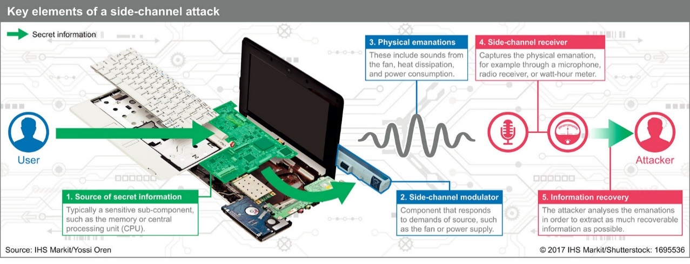
Fysisk ADGANG – proximity
"By measuring the target's electromagnetic emanations, the attack extracts the secret decryption key within seconds, from a target located in an adjacent room across a wall," reads the recently published paper [PDF].

Slide 12
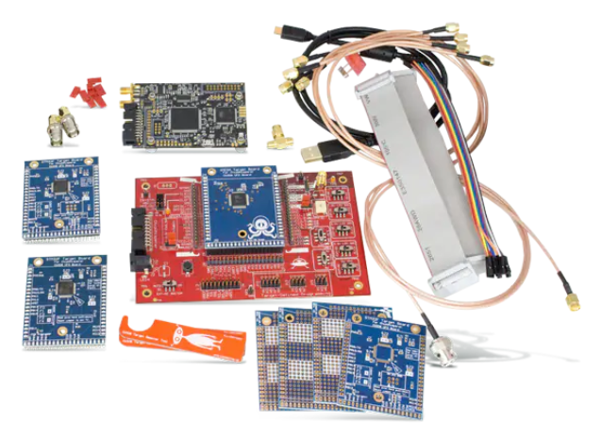
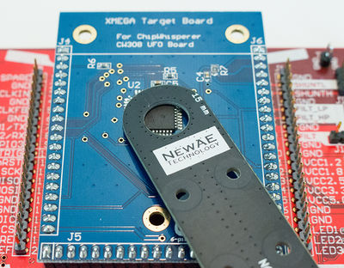
Fysisk ADGANG – proximity

Slide 13
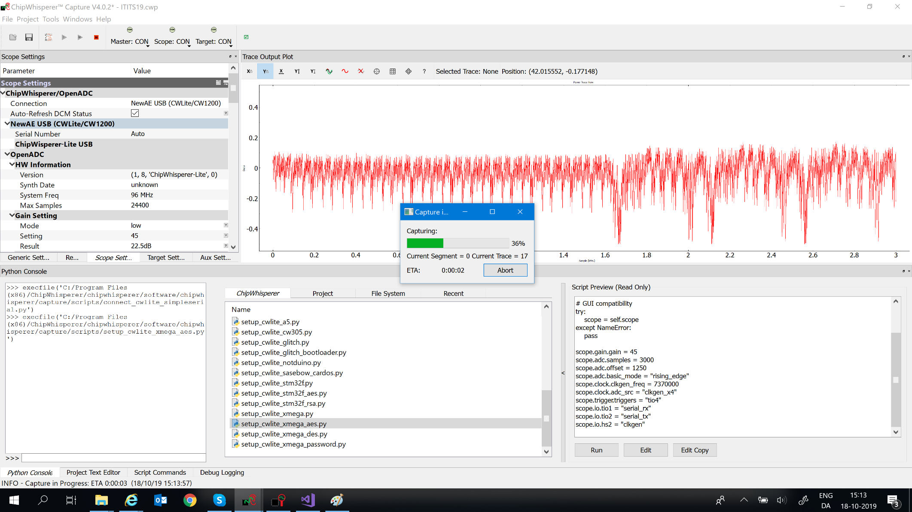
Fysisk ADGANG – proximity

Slide 14
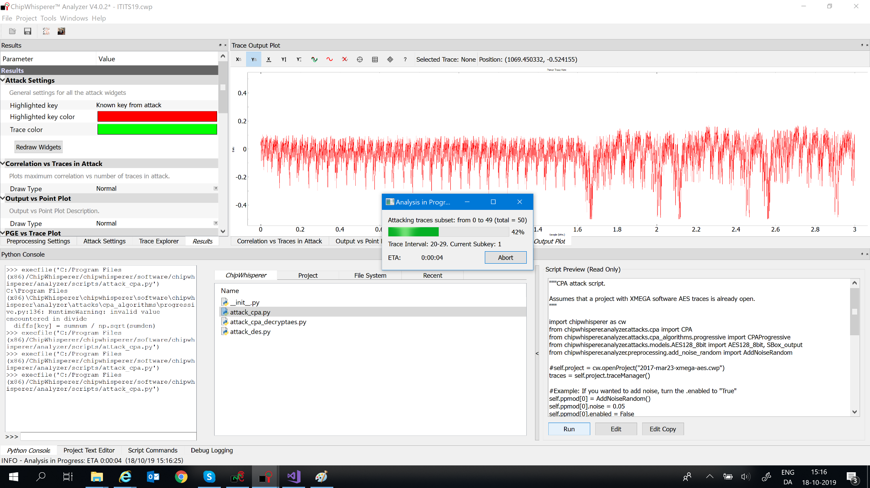
Fysisk ADGANG – proximity

Slide 15
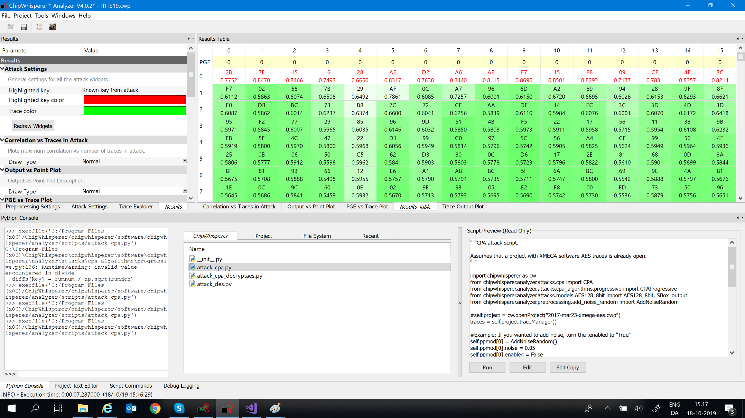
Fysisk ADGANG – proximity

Slide 16
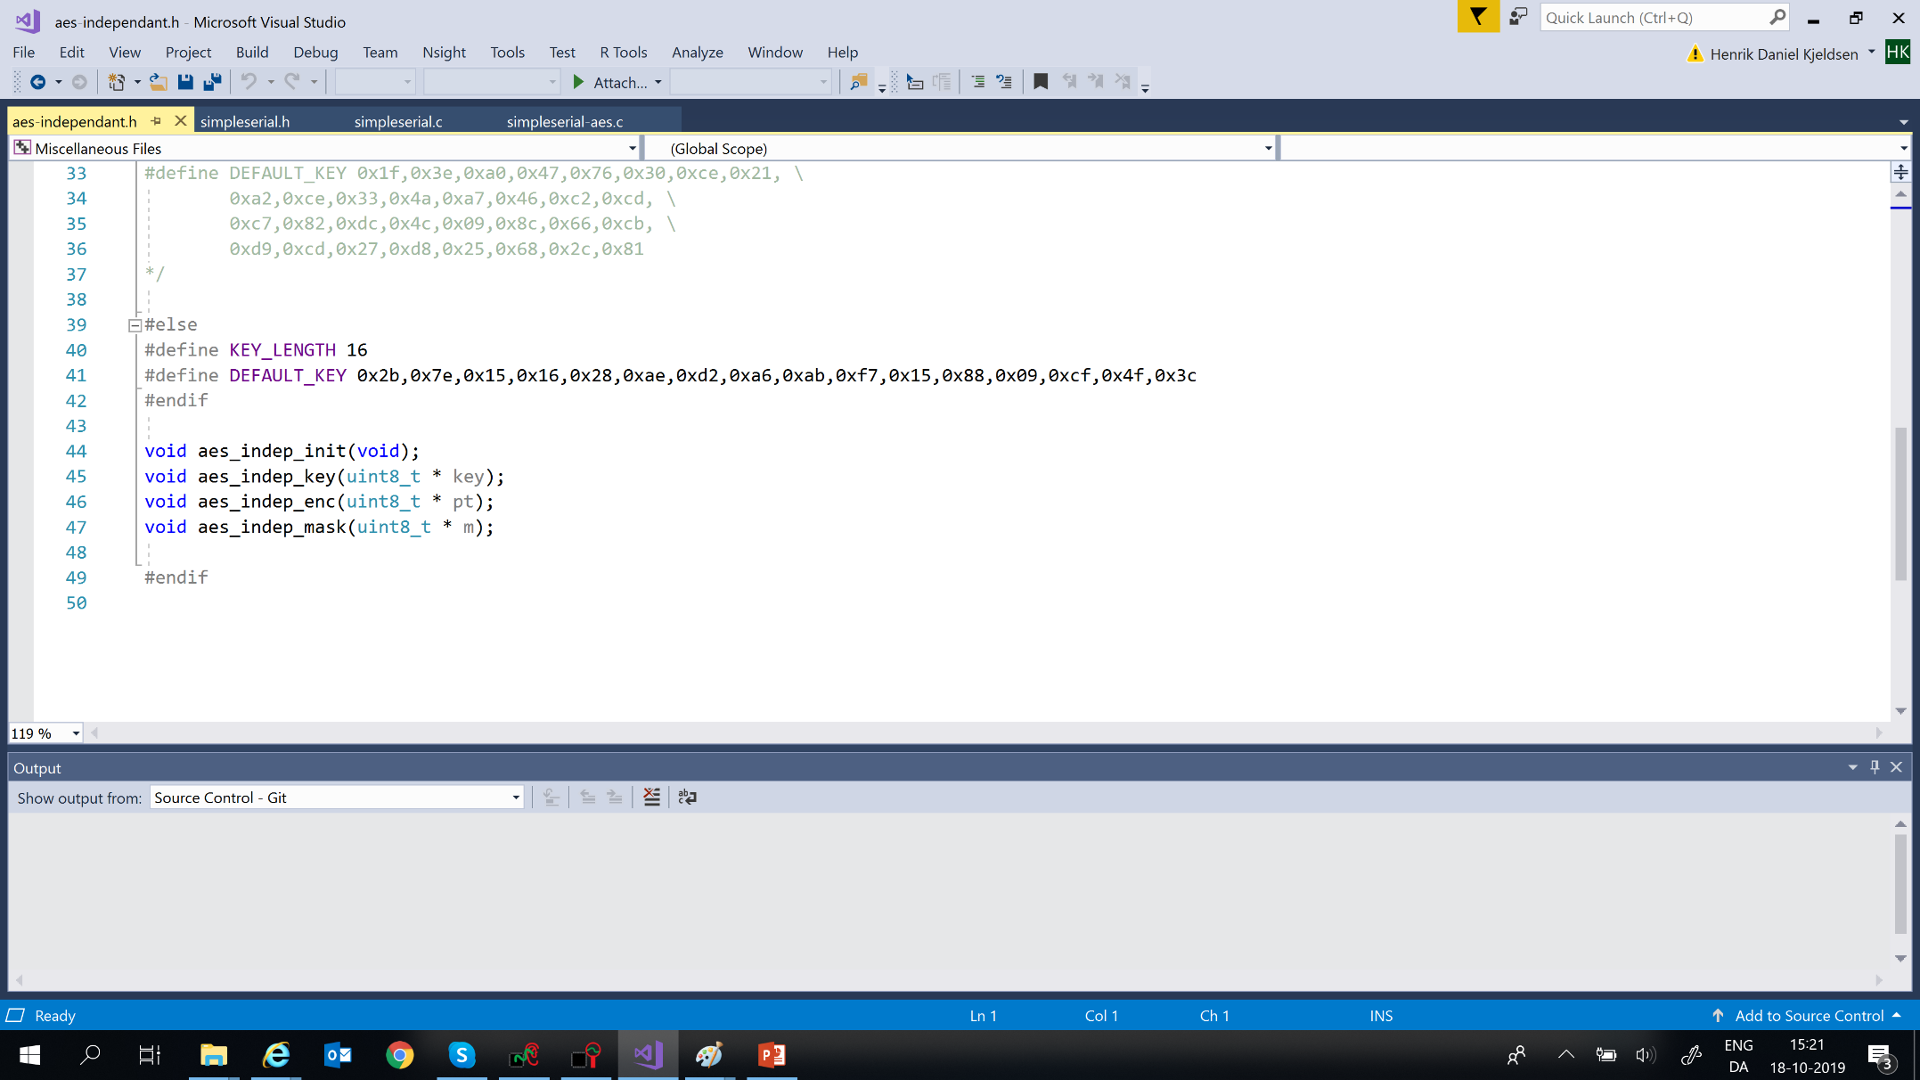
Fysisk ADGANG – proximity

Slide 17
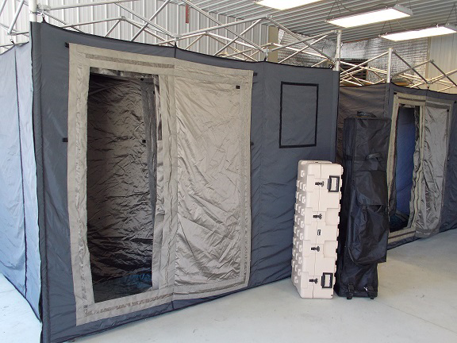
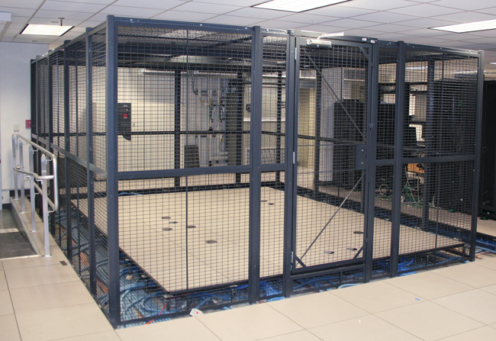
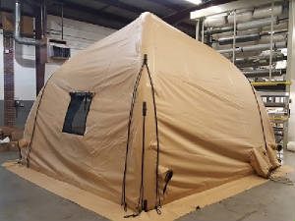
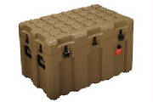
Fysisk ADGANG – proximity
FARADAY EMI Signal Security Shelter

Slide 18
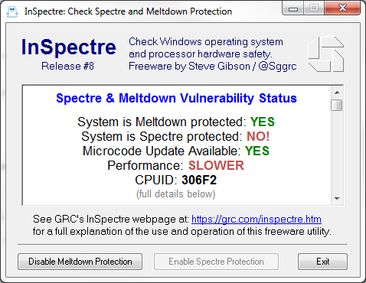
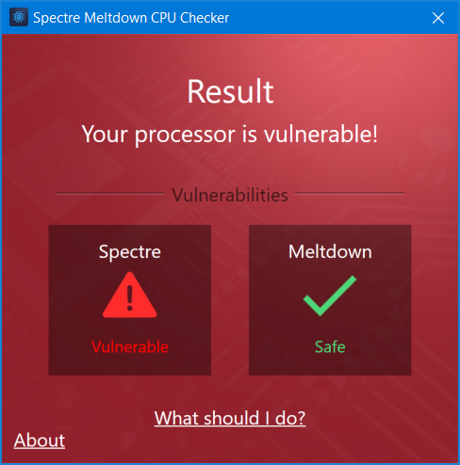
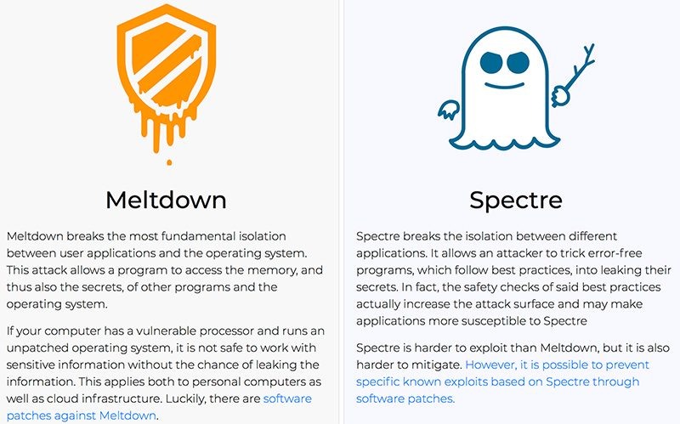
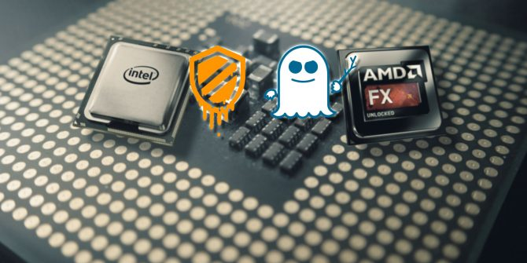
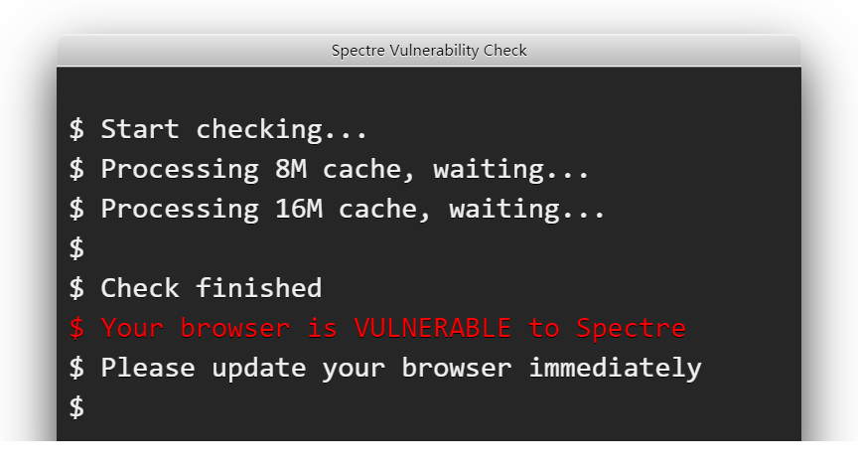
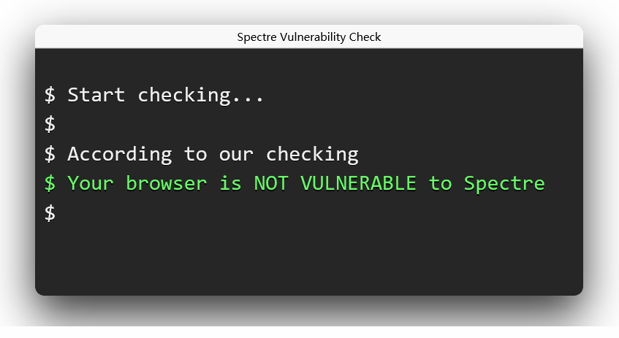
Andre side-channel attacks
https://react-etc.net/entry/javascript-spectre-meltdown-vulnerability-check-for-browsers
https://www.ashampoo.com/en/usd/pin/1304/security-software/spectre-meltdown-cpu-checker

Slide 19
Andre side-channel attacks
https://www.youtube.com/watch?v=q3-xCvzBjGs&t=3s
https://www.youtube.com/watch?v=JSqDqNysycQ

Slide 20
Andre side-channel attacks
https://www.youtube.com/watch?v=L1N1P2zxaZE

Slide 21
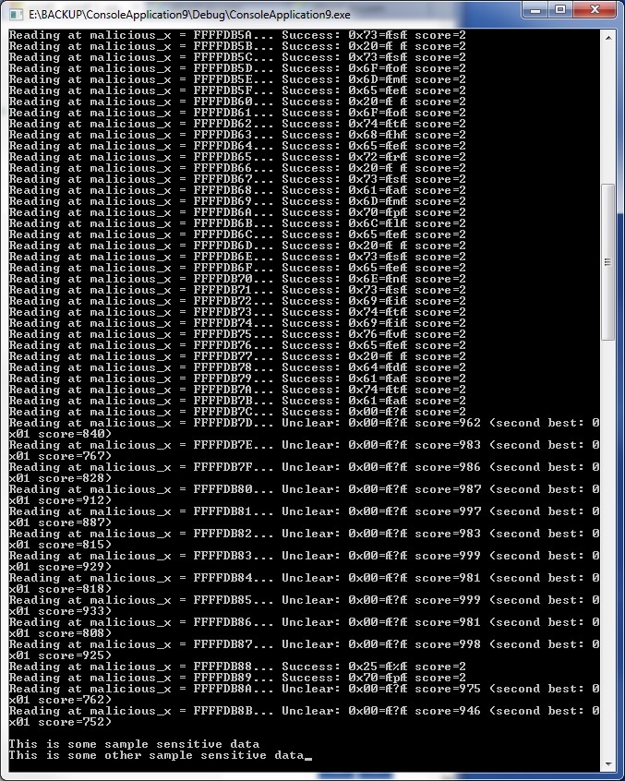
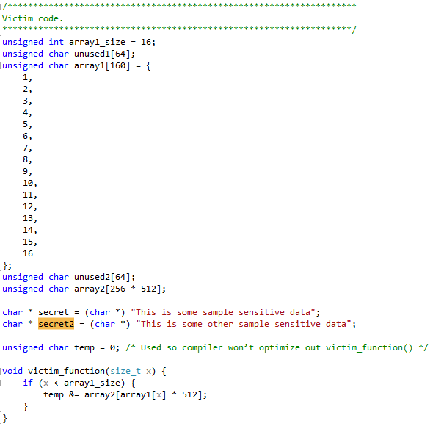
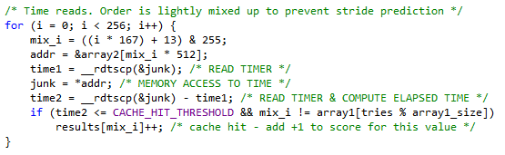
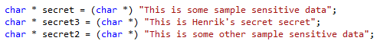
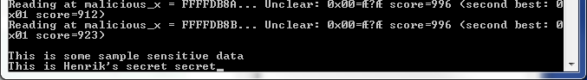
Andre side-channel attacks
https://github.com/flxwu/spectre-attack-demo

Slide 22

Andre side-channel attacks
"Foreshadow: Extracting the Keys to the Intel SGX Kingdom with Transient Out-of-Order Execution" 6 August 2018.

Slide 23
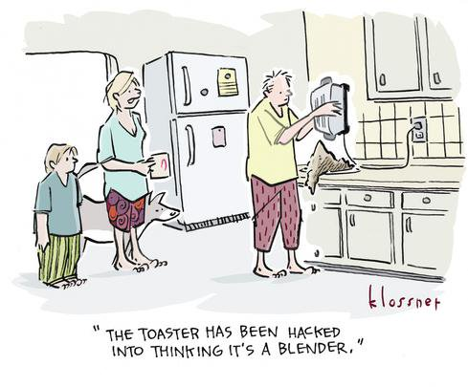
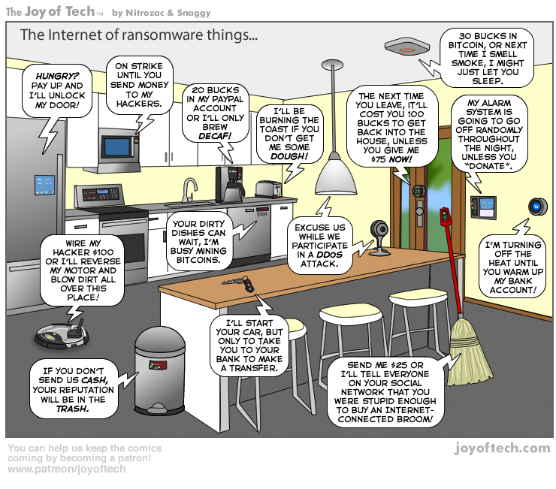
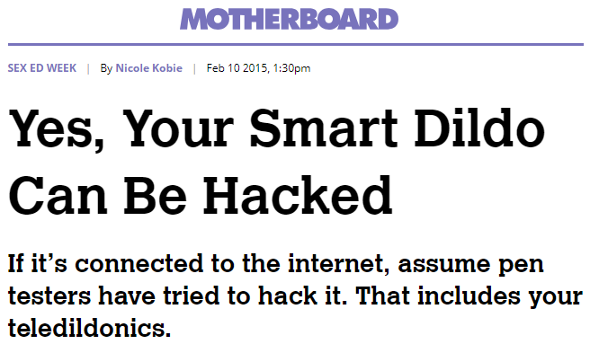

(u)Sikkerhed on the edge

Slide 24
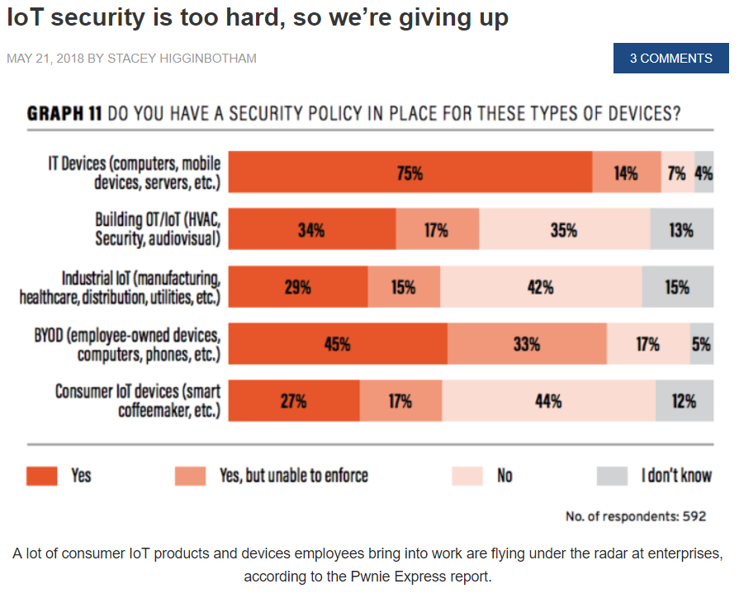
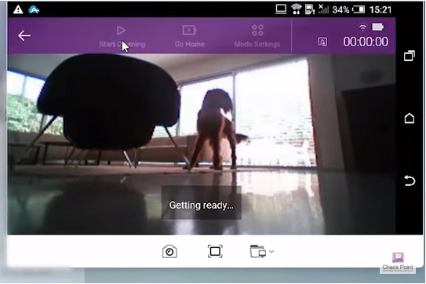
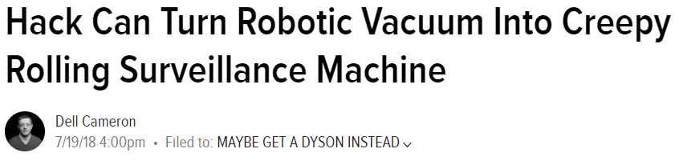

(u)Sikkerhed on the edge

Slide 25



(u)Sikkerhed on the edge

Slide 26
(u)Sikkerhed on the edge
https://arstechnica.com/information-technology/2018/08/researchers-show-alexa-skill-squatting-could-hijack-voice-commands/

Slide 27






(u)Sikkerhed on the edge
Carna botnet

Slide 28

(u)Sikkerhed on the edge - OWASP
0. Assume that users leave default passwords
https://www.owasp.org/index.php/Principles_of_IoT_Security

Slide 29


(u)Sikkerhed on the edge – SECURE BOOT
https://eprint.iacr.org/2008/198.pdf

Slide 30
(u)Sikkerhed on the edge – SECURE BOOT
https://www.timesys.com/pdf/Session_4.3_II_Bhat.pdf

Slide 31


(u)Sikkerhed on the edge – SECURE BOOT
(Assumptions of an impossibility proof)
https://eprint.iacr.org/2008/198.pdf

Slide 32

(u)Sikkerhed on the edge – SECURE BOOT
Key-sharing mellem forskellige leverandører i
produktions processen.
https://eprint.iacr.org/2008/198.pdf

Slide 33




(u)Sikkerhed on the GO – secure boot
Chain of Trust – iPhone boot sequence
https://www.slideshare.net/ka010/jailbreaking-ios

Slide 34

(u)Sikkerhed on the GO – secure boot

Slide 35



(u)Sikkerhed on the GO

Slide 36



(u)Sikkerhed on the GO
https://developer.android.com/training/articles/security-tips

Slide 37



(u)Sikkerhed on the GO
Man-in-the-Disk og Disk-in-the-Middle

Slide 38


(u)Sikkerhed on the GO
Man-in-the-Disk og Disk-in-the-Middle

Slide 39



(u)Sikkerhed on the GO
http://archive.hack.lu/2010/Weinmann-All-Your-Baseband-Are-Belong-To-Us-slides.pdf

Slide 40




(u)Sikkerhed on the GO

Slide 41




Kobayashi Maru – TEST
This is a recreation of an educational test given at US Cyber Command, the Kobayashi Maru, originally from Star Trek Academy..
TASK: Write the first 100 digits of pi (3.14159…) from memory.
OBS. Exceptionally for this specific test and this test only, cheating is allowed!

Slide 42


Rubber Ducky ØVELSE
Design and implement a defense against
Rubber Ducky attacks.

Slide 43


CRYPTO CHIPS ØVELSE
Use a crypto chip to sign and verify a piece of code as a proof of concept for secure boot and firmware signing.
Recommended Python API and examples:
https://github.com/MicrochipTech/cryptoauthtools/tree/master/python/examples
(Chips must be configured before use)
(Other APIs are possible as well)

